Slide 1



In the name of Allah, Most Gracious, Most Merciful.
CacheFlow: Memory-Aware Expert Scheduling for Efficient Mixture-of-Experts Models
Submitted By
Mir Md. Tarhimul Quader (C221017)
Md. Iftaker Ahamed Sayem (C221020)
Turja Dutta (C221026)
Supervisor Jamil As-Ad
Lecturer,
Dept. of CSE, IIUC
Co - Supervisor
Arif Mohammed Asfe
Adjunct Lecturer,
Dept. of CSE, IIUC
Department of Computer Science and Engineering
International Islamic University Chittagong

Slide 2
Introduction

Slide 3
INTRODUCTION
Mixture-of-Experts (MoE) models scale neural networks to trillions of parameters without proportional computational cost.
Only a subset of specialized experts is activated per token, enabling state-of-the-art performance.
MoE deployment is limited by memory bottlenecks, GPU underutilization, and high latency.
This research designs a modular, memory-efficient scheduling and caching framework to optimize inference.
Dynamic token scheduling and caching strategies aim to make large models cost-effective and widely accessible.

Slide 4
Problem Statement

Slide 5
Problem Statement
MoE models require all parameters in memory despite activating few experts per token, causing inefficiencies.
High VRAM demand and execution stalls create significant latency overhead.
Static pinning and naive LRU caching fail to address dynamic workloads efficiently.
Hardware limitations prevent smaller research groups from deploying advanced AI models..
Goal: Develop a memory-sensitive caching and scheduling framework for low-latency, scalable MoE inference

Slide 6
Objectives

Slide 7
Objectives
Concurrency-Aware Scheduling: Develop a token scheduler capable of overlapping computation with expert loading, minimizing idle GPU time.
Dynamic Expert Caching: Design an intelligent caching mechanism that prioritizes high-demand experts based on a composite scoring policy.
Priority-Based Expert Loading Policy: Introduce a scoring system incorporating demand frequency, load cost, confidence levels, and token wait time to guide expert replacement.
Comparative Evaluation: Benchmark against state-of-the-art approaches (vLLM, static pinning, LRU caching) across multiple hardware configurations.
Modular PyTorch Toolkit: Deliver a scalable, extensible implementation for researchers and practitioners.
Ablation Studies & Insights: Provide an in-depth analysis of scheduling complexity, memory usage, and inference trade-offs to inform future MoE optimization research.

Slide 8
Literature Review

Slide 9
Attention Is All You Need
Literature Review
Authors: Vaswani et al., 2017
Impact: This seminal work introduced the Transformer model, replacing recurrent networks with attention mechanisms, enabling full parallelization. This architecture laid the groundwork for modular expert models, providing a scalable base that MoE systems build upon.
Limitations:
• High computational requirements for training and inference
• No focus on sparsity or memory optimization
Paper link

Slide 10
Improving Language Understanding by Generative Pre-Training
Literature Review
Authors: Radford et al., 2018
Impact: This paper demonstrated that large-scale pretraining followed by fine-tuning yields state-of-the-art results, validating transfer learning for NLP. It influenced our approach by emphasizing scalable, reusable model components.
Limitations:
• Requires task-specific fine-tuning
• Does not address inference optimization
Paper link

Slide 11
Literature Review
Language Models are Unsupervised Multitask Learners
Authors: Radford et al., 2019
Impact: This paper demonstrated that large-scale pretraining followed by fine-tuning yields state-of-the-art results, validating transfer learning for NLP. It influenced our approach by emphasizing scalable, reusable model components.
Limitations:
• Extremely high compute cost
• No modularity for deployment efficiency
Paper link

Slide 12
Literature Review
Root Mean Square Layer Normalization
Authors: Zhang & Sennrich, 2019
Impact: Stabilized extremely deep models, improving convergence for large Transformer networks. Relevant for enabling deeper MoE stacks.
Limitations:
• Did not address caching or sparse activation challenges; scaling to trillion-parameter models remained unexplored.
Paper link

Slide 13
Literature Review
GLU Variants Improve Transformer
Authors: Shazeer, 2020
Impact: Introduced gating in FFN layers to enhance representational power, inspiring the gating mechanisms in MoE routing.
Limitations:
• Added training complexity and parameter overhead; inference optimizations were not explored.
Paper link

Slide 14
Literature Review
An Image is Worth 16x16 Words: Transformers for Image Recognition at Scale
Authors: Dosovitskiy, A., et al, 2020
Impact: Introduced Vision Transformer (ViT), applying Transformer architecture to images and outperforming CNNs on large datasets
Limitations:
• Requires massive datasets and compute.
• Less efficient than CNNs for small-scale tasks.
Paper link

Slide 15
Literature Review
Switch Transformers: Scaling to Trillion Parameter Models with Simple and Efficient Sparsity
Authors: Fedus, W., Zoph, B., Shazeer, N. 2021
Impact: Scaled models to trillions of parameters using sparse MoE, routing each token to a single expert.
Limitations:
• Expert load imbalance.
• Communication overhead in distributed setups.
Paper link

Slide 16
Literature Review
LLaMA: Open and Efficient Foundation Language Models
Authors: Touvron, H., et al 2023
Impact: Released open and efficient foundation models that match closed-source LLMs while using fewer resources.
Limitations:
• Limited multilingual coverage.
• Still heavy for low-resource devices.
Paper link

Slide 17
Literature Review
MoE-Infinity: Efficient MoE Inference on Personal Machines with Sparsity-Aware Expert Cache
Authors: Zuo, S., et al 2023
Impact: Proposed sparsity-aware expert caching, enabling MoE inference on personal/edge devices.
Limitations:
• Depends on cache hit rates.
• Complex caching policy management.
Paper link

Slide 18
Literature Review
SwapMoE: Serving Off-the-shelf MoE-based Large Language Models with Tunable Memory Budget
Authors: Yoo, H., Lee, H. 2023
Impact: Introduced memory swapping between CPU and GPU to serve MoE models under tight VRAM budgets.
Limitations:
• Swapping adds latency.
• Requires careful tuning for efficiency.
Paper link

Slide 19
Literature Review
Efficient Memory Management for Large Language Model Serving with PagedAttention
Authors: Kwon, W., et al. 2023
Impact: Proposed PagedAttention to extend context length by paging attention states between CPU and GPU.
Limitations:
• Paging Overhead.
• Bottlenecks at high-throughput loads.
Paper link

Slide 20
Literature Review
DeepSeek-V2: A Strong, Economical and Efficient Mixture-of-Experts Language Model
Authors: Liang, W., et al. 2024
Impact: Designed cost-efficient MoE models achieving strong benchmark results with lower training costs.
Limitations:
• Limited evaluation across diverse languages.
• Optimized mainly for training, not inference.
Paper link

Slide 21
Literature Review
fMoE: Fine-grained and Prompt-aware Expert Offloading for Large Mixture-of-Experts Serving
Authors: Shen, X., et al. 2024
Impact: Introduced fine-grained, prompt-aware expert offloading to improve efficiency during inference.
Limitations:
• Scheduling complexity.
• Higher engineering overhead.
Paper link

Slide 22
Methodology

Slide 23
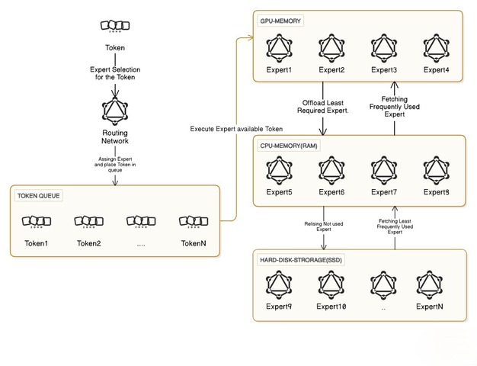
Proposed Methodology
Figure: A diagram of the Proposed Architecture

Slide 24
Overview
Proposed Methodology
Sparse MoE Transformer with selective expert activation.
Dynamic Expert Caching to keep high-demand experts in GPU memory.
Token Scheduling Engine for concurrency-aware execution
Deferred Queues to handle tokens needing non-cached experts.
Parallel Execution using CUDA streams to minimize idle GPU time.
Evaluation & Benchmarking with vLLM PagedAttention dataset.

Slide 25
Proposed Methodology
1. Token Scheduling Engine
• Tracks tokens and their required experts.
• Schedules cached experts immediately, defers uncached tokens.
• Ensures maximum concurrency to keep GPUs fully utilized.
2. Dynamic Expert Caching Strategy
• Maintains a prioritized set of experts in GPU memory.
• Uses a composite priority score (demand frequency, load cost, confidence, wait-time).
• Reduces memory overhead by evicting low-utility experts.

Slide 26
Proposed Methodology
3. Execution Loop & Queue Management
• Orchestrates scheduling and background expert loading.
• Uses asynchronous streams for overlap of computation and I/O.
• Keeps GPUs active while deferred tokens wait for expert availability.
4. Evaluation & Benchmarking
• Will be benchmarked with vLLM PagedAttention dataset.
• Metrics: throughput, latency, cache hit rate.
• Compared against static pinning, naïve LRU caching and synchronous loading.

Slide 27
Expected Outcomes

Slide 28
Expected Outcome
Efficient Inference: Reduced GPU idle time and latency through concurrency-aware scheduling.
Memory Optimization: Dynamic caching strategy enables MoE models to run on limited VRAM devices.
Scalable Deployment: Priority-based expert management adapts to different workloads and model sizes.
High Throughput Under Constraints: Achieve near-optimal throughput compared to state-of-the-art deployments, even with strict memory limits
Robust Benchmarking: Comprehensive evaluation with metrics like throughput, latency and cache hit rate.
Open-Source Contribution: Modular PyTorch toolkit to support researchers and democratize MoE deployment.
Democratizing AI Access: Enable large-scale MoE inference on affordable hardware, supporting smaller research groups and institutions.

Slide 29
Grantt Chart

Slide 30
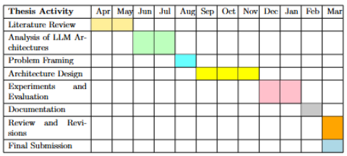
Gantt Chart

Slide 31
Conclusion

Slide 32
Conclusion
This research addresses the critical gap between the theoretical scalability of Mixture-of-Experts (MoE) models and their practical deployment under strict hardware constraints. By introducing a memory-aware caching strategy, a concurrency-driven token scheduling mechanism, and modular system design, our framework enables efficient and low-latency inference on consumer-grade GPUs. The expected contributions include improving throughput, reducing latency, and democratizing access to advanced large-scale AI models, thus paving the way for more resource-efficient and accessible AI research and applications.
11

Slide 33
References

Slide 34
References
Vaswani, A., et al. Attention Is All You Need. NeurIPS, 2017. arXiv:1706.03762
Radford, A., et al. Improving Language Understanding by Generative Pre-Training. OpenAI, 2018. OpenAI
Radford, A., et al. Language Models are Unsupervised Multitask Learners. OpenAI, 2019. OpenAI
Zhang, B., Sennrich, R. Root Mean Square Layer Normalization. NeurIPS, 2019. arXiv:1910.07467
Shazeer, N. GLU Variants Improve Transformer. arXiv preprint, 2020. arXiv:2002.05202
Dosovitskiy, A., et al. An Image is Worth 16x16 Words. ICLR, 2020. arXiv:2010.11929
Fedus, W., et al. Switch Transformers. JMLR, 2021. arXiv:2101.03961
Touvron, H., et al. LLaMA: Open and Efficient Foundation Models. arXiv, 2023. arXiv:2302.13971
Zuo, S., et al. MoE-Infinity. arXiv, 2023. arXiv:2305.11794
Yoo, H., Lee, H. SwapMoE. arXiv, 2023. arXiv:2309.09515
Kwon, W., et al. PagedAttention. SOSP, 2023. arXiv:2309.06180
Liang, W., et al. DeepSeek-V2. arXiv, 2024. arXiv:2405.04434
Shen, X., et al. fMoE. arXiv, 2024. arXiv:2403.12881
12

Slide 35
Appendix

Slide 36
Appendix
Our progress so far
GitHub Repository
HuggingFace Model
Our own individual implementation of GPT-2(124 M)
Md. Iftaker Ahamed Sayem
Mir Md. Tarhimul Quader
Turja Dutta
12

Slide 37
Thank You

